Slide 1
Hyderabad Institute of Technology and Management
Carbolens: AI-Based Generalized Risk Monitoring Framework for Carbon Sequestration Projects
Student details:
Sarah Snigdha (23E51A66A3)
Pranathi Swamy (23E51A6690)
Tulugu Mavya Sri (23E51A66B4)
Vishnu Vardhan (23E51A66C8)
Date: 22-08-2026
Mentor: Dr. Rajeshwar

Slide 2
Table of Contents
Introduction
Literature Review
Problem Statement
Motivation
Objectives
Abstract
Existing Work
Proposed Work
Technologies
System Flow
Expected Results
Applications
Conclusion
References
Project Plan

Slide 3
Introduction
What is Carbon Sequestration?
Carbon sequestration is the process of capturing and storing atmospheric CO₂ in natural or engineered systems.
Major forms include:
Biological: forests, soil, wetlands, mangroves
Geological: underground storage of captured CO₂
Technological: engineered carbon capture and storage
The Challenge
Storing carbon is not enough.
We also need to know:
How much carbon is being stored, whether the project is performing as expected, and whether the stored carbon is likely to remain stored.
This project proposes a generalized, data-driven framework to monitor sequestration projects, assess potential risks, and provide early warnings through a GIS-based platform.

Slide 4
Literature Review
Study | Methodology | Findings | Limitations
Elkholy & Anandhi (2025/26) – Biological and geological carbon sequestration monitoring techniques: A review | Systematic review of 56 studies; analyzed remote sensing, ML, field and integrated methods | Remote sensing provides wide coverage; ML shows promise; integrated monitoring is comprehensive | Validation is often insufficient; remote sensing has classification challenges; methods can be complex
Bordoloi et al. (2021/22) – Satellite-based modelling of carbon stock in Northeast India | Field inventory + Landsat OLI; NDVI, SAVI, ARVI + regression and CO₂FIX | Estimated biomass, carbon stock and sequestration potential across different land uses | Moderate-resolution Landsat data; regression limitations; field validation required
Zhang et al. (2021) – CO₂ capture and storage monitoring using remote sensing | Review of remote-sensing techniques for CO₂ storage and leakage monitoring | Remote sensing enables wide-area, non-contact and long-term monitoring | Remote sensing alone cannot provide complete monitoring; additional monitoring methods may be required

Slide 5
Problem Statement
“Carbon sequestration projects store CO₂ in ecosystems, but drought, wildfire, vegetation loss, and land-use change can threaten long-term carbon storage.
Existing monitoring methods are often project-specific and use fragmented data sources, making consistent risk assessment difficult.
This project proposes a generalized framework integrating satellite, climate, land-cover, fire, biomass, and project data to monitor different sequestration projects.
The system will normalize indicators, detect anomalies, assess risks, and provide standardized early warnings through a GIS-based dashboard.
”
Current challenges include:
Difficulties in continuously monitoring large areas
Changes in vegetation and land cover
Drought and climate-related stress
Wildfires and other disturbances
Difficulty detecting potential carbon loss
Differences between reported project data and observed conditions
Need for reliable long-term monitoring

Slide 6
Motivation
Why this project?
Carbon sequestration is increasingly important for climate-change mitigation.
However:
Carbon removal claim does not necessarily mean guaranteed permanent storage.
A project may initially store carbon but later experience:
Drought
↓
Vegetation stress
↓
Vegetation loss
↓
Reduced carbon storage
↓
Potential carbon release
Therefore, there is a need for a system that provides continuous, data-driven monitoring rather than relying only on periodic reports.

Slide 7
Objectives
Primary Objective
Develop an AI-enabled platform for monitoring carbon sequestration projects and assessing their permanence risk.
Specific Objectives
Monitor vegetation and land-cover changes using satellite data.
Integrate climate and environmental data.
Estimate carbon-storage trends.
Detect unusual or significant environmental changes.
Identify factors that may contribute to carbon loss.
Develop a permanence-risk assessment model.
Compare reported project information with observed indicators.
Provide alerts for potentially degraded or high-risk areas.
Visualize project conditions using an interactive GIS dashboard.
Provide AI-assisted explanations of detected risks.

Slide 8
Abstract
Carbon sequestration is an important approach for reducing atmospheric carbon dioxide by storing carbon in natural or geological systems. However, continuously monitoring the amount of carbon stored and determining whether it is likely to remain stored over time is a significant challenge. This project proposes an AI-Based Carbon Sequestration Monitoring and Permanence Risk Assessment Platform that uses satellite imagery, vegetation indicators, land-cover information, climate data, and project-level information to monitor carbon sequestration sites. The system analyzes changes in vegetation and environmental conditions to estimate carbon-storage trends and identify potential risks of carbon loss caused by factors such as drought, wildfire, vegetation degradation, and land-use change. Machine learning techniques can be used for anomaly detection, trend analysis, and permanence-risk assessment. A GIS-based dashboard will provide visualization of sequestration projects, historical changes, carbon estimates, risk levels, and alerts. The system can also compare reported project information with observed environmental indicators to identify potential inconsistencies requiring further investigation. The proposed platform aims to improve the monitoring, transparency, and reliability of carbon sequestration projects through an integrated software, AI, and geospatial approach.

Slide 9
Existing work
Carbon sequestration projects use:
Field measurements
Satellite and remote sensing data
Biomass and carbon-stock models
Land-cover and climate data
Limitations
Difficult to monitor large areas continuously
Carbon estimates contain uncertainty
Data from different sources can be difficult to integrate
Long-term carbon permanence is difficult to assess
Opportunity
Integrate satellite, environmental, AI/ML, and GIS data into a single monitoring platform.

Slide 10
Proposed Work
Carbon Sequestration Monitoring Platform
The proposed system will:
Collect satellite, climate, land-cover, and project data
Analyze vegetation and carbon-storage trends
Detect environmental changes and anomalies
Assess carbon permanence risk
Generate risk alerts for potentially degraded areas
Provide results through an interactive GIS dashboard
Core Flow
Data Collection → Data Processing → AI/ML Analysis → Risk Assessment → GIS Dashboard
Notes:
Normalized Difference Vegetation Index ndvi.

Slide 11
Specifications/Technologies
Development
Python, FastAPI
React.js
PostgreSQL / PostGIS
AI & Data Processing
Machine Learning
Pandas, NumPy
Anomaly Detection
Data & GIS
Remote Sensing
GIS / Spatial Analysis
Landsat, Sentinel
NASA Earthdata, Copernicus

Slide 12
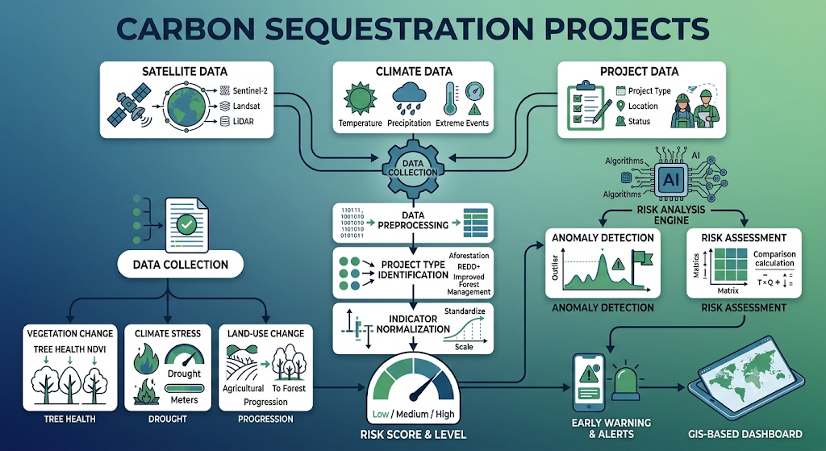
Block Diagram/Flow Chart

Slide 13
Expected Result
Monitor carbon sequestration projects using satellite and environmental data.
Track vegetation and carbon-storage trends over time.
Detect vegetation loss, land-use changes, and environmental anomalies.
Identify factors that may contribute to carbon loss.
Generate low, medium, and high permanence-risk indicators.
Provide GIS visualization and alerts for potentially high-risk areas.

Slide 14
Applications
Forest Carbon Projects — Monitor afforestation and reforestation.
Agriculture — Track vegetation and soil-based sequestration.
Blue Carbon — Monitor mangroves and wetlands.
Carbon Project Developers — Track project performance and risks.
Researchers & Environmental Organizations — Analyze carbon and environmental trends.

Slide 15
Conclusion
The system integrates satellite, climate, land, and project data to enable comprehensive carbon monitoring. It uses AI/ML and GIS technologies to track environmental changes that may affect carbon storage, assess permanence risks, and provide timely alerts. This enables scalable, data-driven monitoring and improved management of carbon sequestration projects.

Slide 16
References
Matiza et al. (2023) — Remote Sensing & ML for Carbon Storage
Research Paper
Nguyen & Saha (2024) — ML & Remote Sensing for Forest Carbon
Research Paper
Huang et al. — Remote Sensing & Forest Carbon Monitoring
Research Paper
Copernicus — Sentinel-2 Satellite Data
Data Source
NASA FIRMS — Near-Real-Time Fire Data
Data Source
Global Forest Watch — Forest Monitoring Data
Data Source

Slide 17
Project Flow(plan for the next review)
Research Gap
Identify limitations in current approaches.
↓
Dataset Selection
Finalize satellite, climate, and land datasets.
↓
Methodology
Select carbon-estimation and risk-assessment methods.
↓
System Design
Finalize architecture, database, and GIS workflow.
↓
Initial Prototype
Implement data processing and basic monitoring dashboard.

Slide 18

THANK YOU

